Slide 1

Using BioGrids for RNA-Seq on AWS and Your Laptop
James Vincent
BioGrids Consortium
Harvard Medical School
TMEC 304
July 25 2019

Slide 2
Today we will .....
Install software with BioGrids
Run an RNA-Seq workflow
Replicate above on AWS and laptop

Slide 3


BioGrids on AWS
faithful laptop
AWS EC2 Instance

Slide 4
RNA-Seq Workflow
open a terminal
open a browser: biogrids.org/wiki/workshops

Slide 5
Subtle Things
Capsule Environment
.bashrc / .profile not changed
binary installs

Slide 6
Avoid Time Sinks
https://www.biostars.org/p/189261/:
This seems to be a bug when installing fastqc using apt-get install fastqc
STARmanual.pdf
….which creates problems for STAR compilation. One option to avoid this problem is to install gcc …….
http://github.gersteinlab.org/exceRpt/
Manual Installation:
….generally not recommended … <snip> … instructions on how to install exceRpt and its various dependencies will [one day] be listed toward the bottom of this page.

Slide 7
Reproducible Research
Self Documenting
$ STAR --sbapp:d
Capsule:STAR using star version 2.5.3a
Version information for: /programs/i386-mac/star
Default version: 2.5.3a
In-use version: 2.5.3a
Other available versions: none
Overrides use this shell variable: STAR_M
Include in workflow:
STAR --sbapp:d
samtools --sbapp:d

Slide 8
Config File
[installer]
site = biogrid-production
key = 70rYFBTDnmCr93VUklfbf1s3M4jdyC9bFVYHew==
user = jvincent1
[packages]
star@2.5.3a = i386-mac
samtools@1.5 = i386-mac
igv@2.4.10 = i386-mac

Slide 9
This Is Handy
faithful laptop
new workstation
biogrids save mysetup.txt
biogrids reactivate mysetup.txt

Slide 10

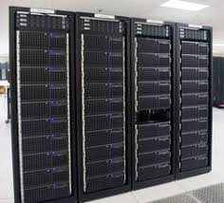
BioGrids is Portable
laboratory workstation
faithful laptop
HMS O2 compute cluster
BCH compute cluster

Slide 11
BioGrids Benefits
save time - reduce headaches
scale and share workflows
part of reproducible research

Slide 12




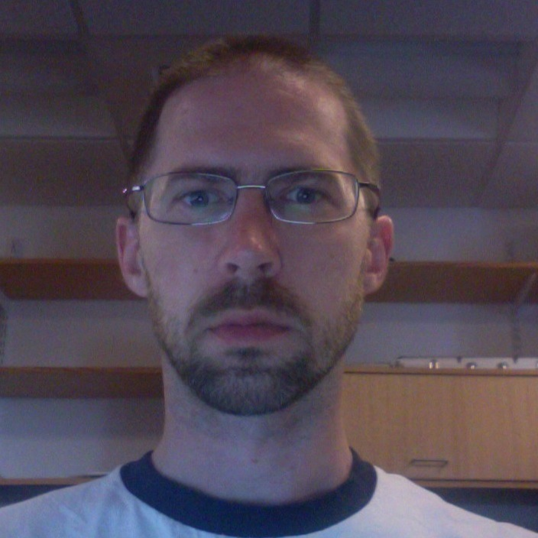

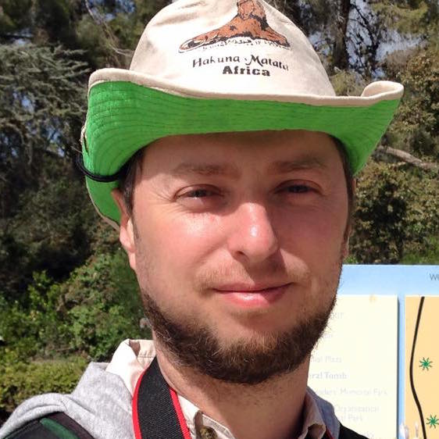



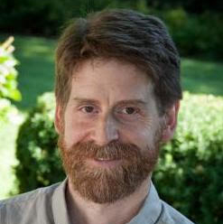


BioGrids Consortium
Personnel
SBGrid
BioGrids
Compute Infrastructure
Funding
HMS Tools and Technologies Committee

Slide 13
Why BioGrids?
You
Cover of Nature
compile software
compile libraries
manage dependencies
manage versions
manage paths
change versions
....
learn to use software
optimize workflow
get science done

Slide 14
RNA-Seq Overview
Harvard Chan Bioinformatics Core (HBC)
http://bioinformatics.sph.harvard.edu/training

Slide 15
RNA-Seq Overview
Biological samples / Library prep
sequence reads
quality check
adapter/quality trimming
splice aware mapping to genome
count reads associated with genes
statistical analysis identify differentially expressed genes
hbctraining.github.io/Intro-to-rnaseq-hpc-O2

Slide 16
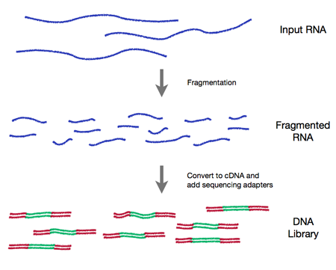
RNA Prep

Slide 17
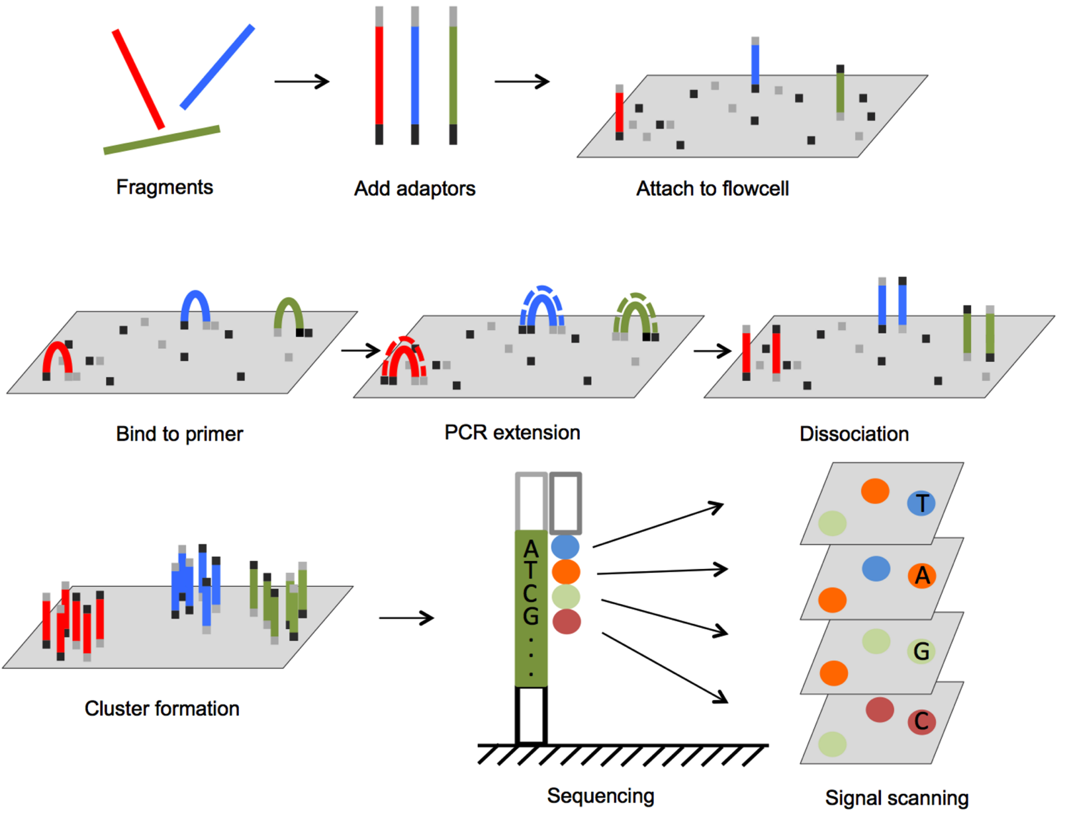
Sequencing

Slide 18
RNA-Seq Overview
Biological samples / Library prep
sequence reads
BioGrids Apps
quality check
FastQC
adapter/quality trimming
(trimmomatic)
splice aware mapping to genome
STAR
count reads associated with genes
subRead
statistical analysis identify differentially expressed genes
hbctraining.github.io/Intro-to-rnaseq-hpc-O2

Slide 19
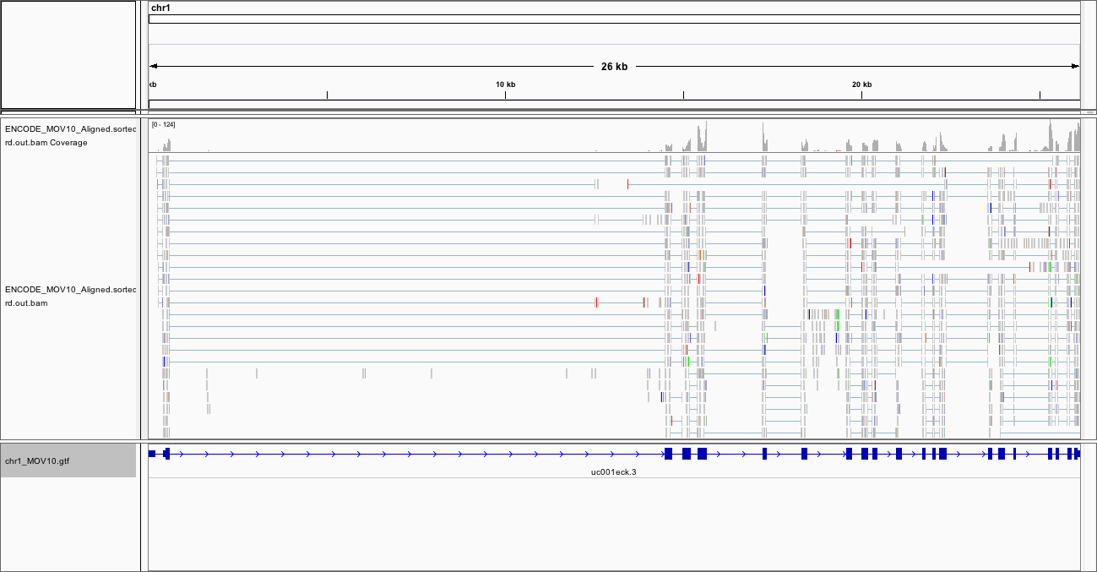
Mapped Reads

Slide 20
Check Results
IGV
1: Genomes / Load Genome from File... (chr1_MOV10.fa)
2: File / Load from file... (.gtf file)
3: File / Load from file... ( .bam file)

Slide 21
DevOps with BioGrids
software
stack
compute
resources
workflow
laptop
HMS O2
AWS
bioinformatics
BioGrids

Slide 22
AWS Hands On
https://sbgrid.signin.aws.amazon.com/console
username: workshop21
password: Biogrids_Workshop1

Slide 23
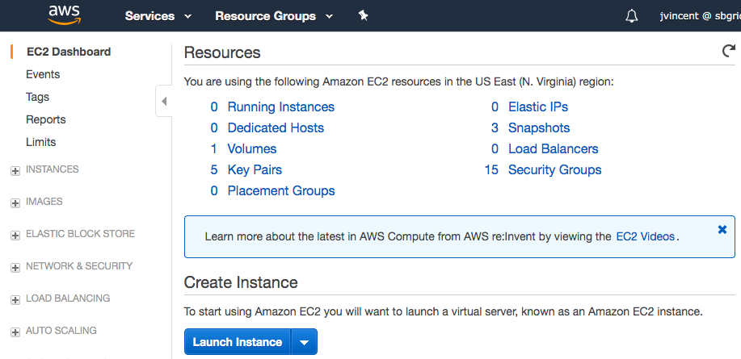
AWS - Amazon Web Services

Slide 24
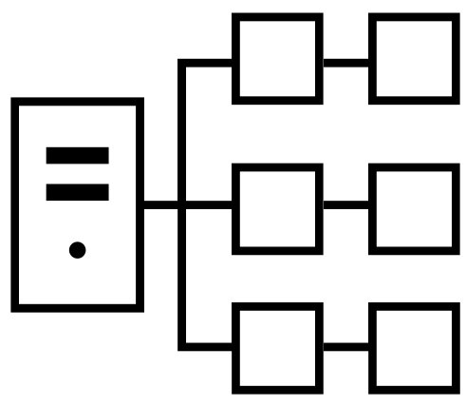
AWS Parallel Cluster
aws-parallelcluster.readthedocs.io
scalable HPC cluster

Slide 25
help@biogrids.org
BioGrids is funded by the
Harvard Medical School
Tools and Technologies Committee

Slide 26
Additional Resources
ENCODE data files can be found here for CalTech RNA-Seq :
http://hgdownload.cse.ucsc.edu/goldenPath/hg19/encodeDCC/wgEncodeCaltechRnaSeq/
Use this bam file: wgEncodeCaltechRnaSeqK562R1x75dAlignsRep1V2
Region of MOV10 gene: chr1:113,214,934-113,243,900
How to download whole genome:
- UCSC ftp site: hgdownload.cse.ucsc.edu
- UCSC web site: http://hgdownload.cse.ucsc.edu/goldenPath/hg19/chromosomes/
- UCSC recommends using an ftp client for large file downloads
- chr1 is only 70M

Slide 27
References
TRAINING
hbctraining.github.io/Intro-to-rnaseq-hpc-O2
AWS
https://aws.amazon.com/ec2/getting-started
ENCODE
https://www.encodeproject.org
IMAGES
https://www.diagenode.com/en/categories/Library-preparation-for-RNA-seq
https://rnaseq.uoregon.edu

